Slide 1

Morning Coffee Advanced Unit Testing
With Dave and Bill

Slide 2

Unit Testing Problems
Testing only the functionality you should test
Isolating the thing you want to test from the things it needs

Slide 3
Unit Tests
Figuring out what you are going to unit test is difficult!
A unit test should only test:
ONE execution path
In ONE method
In ONE class
A Unit Test you write should only be testing code you wrote unless:
You are pair programming
You are fixing a reported defect in legacy code
You are refactoring legacy code

Slide 4
What to Test?
The requirement: fill an Order if stock is available
Acceptance criteria:
If there is sufficient stock:
The order status should be “FILLED”
The Order should be for the correct Product and quantity
The Warehouse stock of the product should be reduced by the amount used to fill the order
If there is insufficient stock:
The Order status should be “BACKORDER”
The Warehouse stock of the Product should not be changed
The Domain Model
Order
Warehouse
LineItem
Product

Slide 5

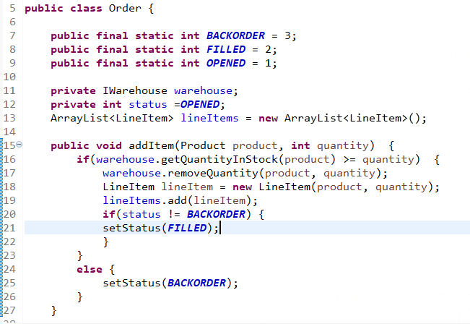
The Order Class
We built a testing seam in the Order Class
The dependency is on IWarehouse
We used setter injection (not shown)

Slide 6

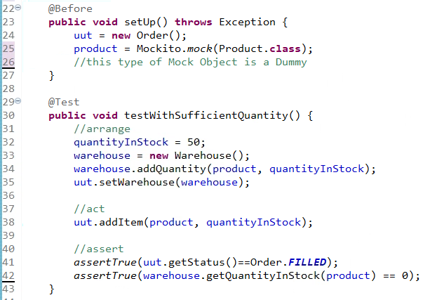
The First Test
Do you see the problem?
Notes:
Do you see the problem here?

Slide 7

Recommended Steps
Declare the object you are going test
Give it an appropriate name (uut, sut, cut, etc)
Write the assert()statement
The assert()statement should be about the uut!
Write the rest of the test in Arrange – Act – Assert format

Slide 8

Testing
Testing Code
Stimulus
Code Under Test
Response
(C) 2021 Fairfield & Company
Notes:
As we saw yesterday, testing a leaf object is simple!

Slide 9
Dependencies Make Testing Difficult!
Other class
Other class
Other class
Testing Code
Stimulus
Code Under Test
Other class
Other class
Response
Other class
Other class
Other class
(C) 2021 Fairfield & Company
Notes:
Testing a non-leaf object is much more difficult. We have to deal with all of the dependencies when creating the test.
If the unit under test creates objects, it is untestable.

Slide 10
Test Doubles
Test Double
(Dummy)
Testing Code
Stimulus
Code Under Test
Test Double
(Stub)
Test Double
(Mock)
Response
Test Double
(Spy)
(C) 2021 Fairfield & Company

Slide 11

Dependency Types
Dependencies can arise in several different ways
We will look at:
State
Behavior
Inheritance
Each situation requires a different type of Test Double

Slide 12
Dependency Type: State Test Double type: stub
This type of dependency occurs when our uut needs information from something it depends on
We have seen this several times
Order needs information from Warehouse
UmbrellaDecisionEngine needs information from a WeatherForecaster
Design approach:
Depend on an interface
Use dependency injection
Testing approach with Mockito:
Mock the interface
Configure the mocked object with behavior
Inject the mocked object into the uut.
Use assert() statements to insure that the right result was obtained.

Slide 13

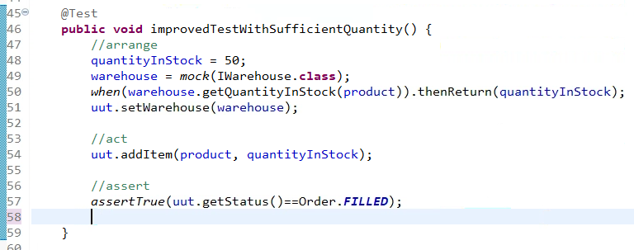
Verifying State
Mock the Interface
Configure behavior
Dependency Injection
Use an assert() statement

Slide 14
Dependency Type: Behavior Test Double type: mock
This type of dependency occurs when our uut should call an operation on another object
The test should confirm that the operation was called correctly
Design approach:
Depend on an interface
Use dependency injection
Testing approach with Mockito:
Mock the interface
Inject the mocked object into the uut.
Use verify() statements to insure that the right method was called.

Slide 15
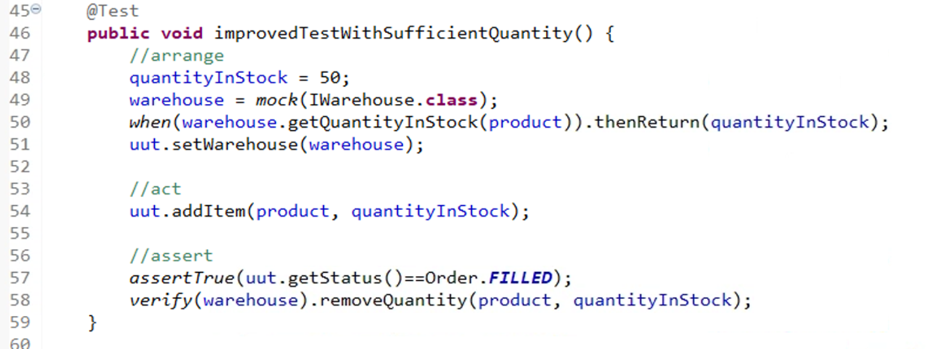
Verifying Method Calls
Mock the Interface
Dependency Injection
Use a verify() statement
Notes:
In this case, the Warehouse is both a mock and a stub!

Slide 16
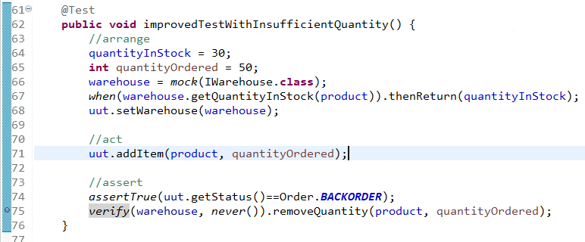
Verifying Method Not Called
Mock the Interface
Dependency Injection
Use a verify() statement

Slide 17
Dependency Type: Inheritance Test Double type: spy
This type of dependency occurs when the uut is created from a subclass
The uut inherits the implementation of a (complicated) operation
The uut uses the results of the inherited operation in one or more of its methods
In order to test, we need to control the return value from the inherited (complicated) operation
Design approach:
Don’t design this way!
But you will encounter this in legacy code
Testing approach with Mockito:
Spy the uut Class
Configure the spy with behavior
Use verify()or assert() statements as necessary

Slide 18
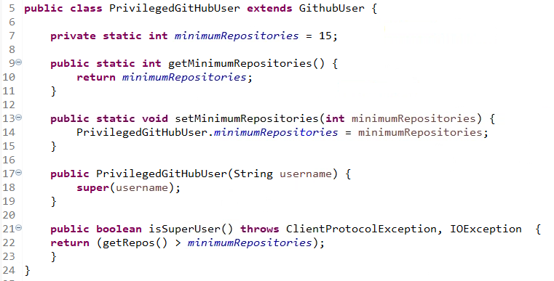
Inheriting Behavior
GithubUser
userName
getRepos()
PrivilegedGithubUser
(static) minRepos
isSuperUser()
Notes:
The isSuperUser() operation uses the inherited getRepos() operation

Slide 19
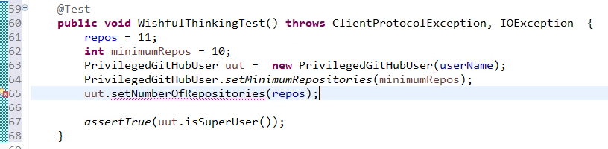
The Test I’d Like to Write
Notes:
But I cannot, because there is no setNumberofRespositories in either the sub or the super class!

Slide 20
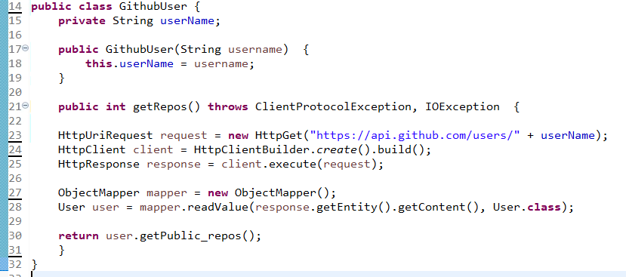
Examining the Super Class Code

Slide 21


The Trap
We are not testing the super class code!

Slide 22

Back to Basics
We did not write the super class code.
It is not our job to test it.
We need a way to control the return value of the inherited operation
We do this with a spy

Slide 23
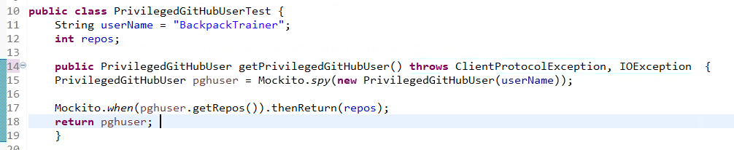
Setting Up the Spy
Spy the uut
Configure behavior in the Spy
Notes:
But I cannot, because there is no setNumberofRespositories in either the sub or the super class!

Slide 24
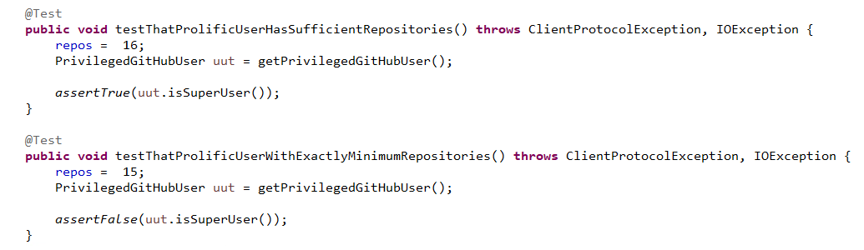
Using the Spy

Slide 25



Questions?
THANK YOU

